Slide 1
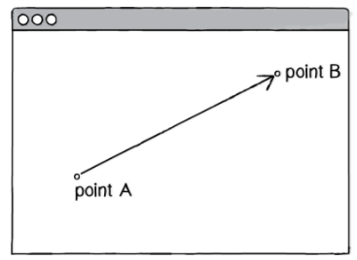
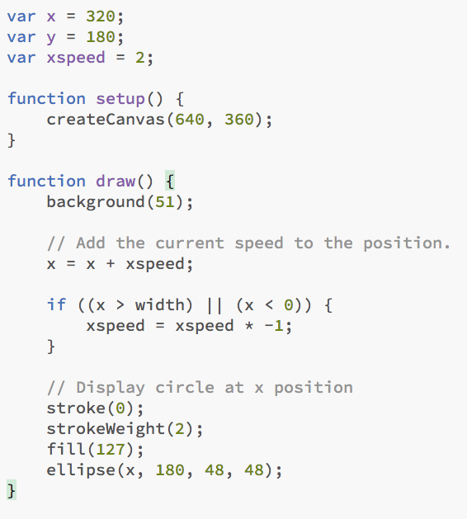
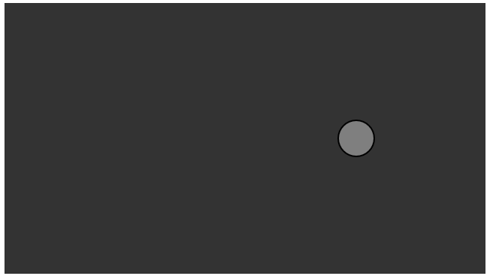
Chapter 2. Vectors
Vector Victor Vector we have a problem....
A vector is typically drawn as a arrow; the direction is indicated by where the arrow is pointing, and the magnitude by the length of the arrow itself. In the above illustration, the vector is drawn as an arrow from point A to point B and serves as an instruction for how to travel from A to B.
Sketch15.js
Bouncing ball with no vectors in one direction

Slide 2
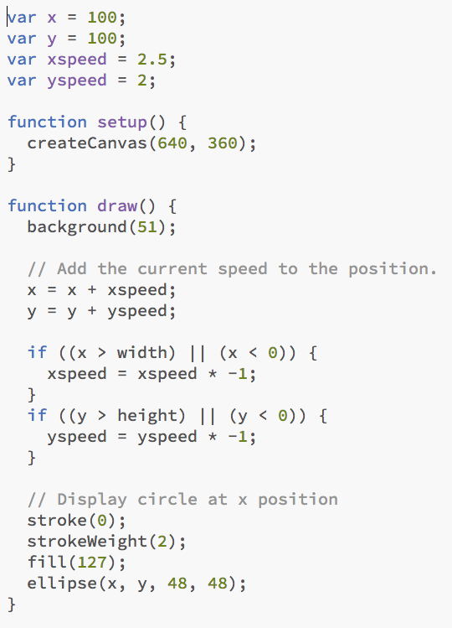

Chapter 2. Vectors
Vector Victor Vector we have a problem....
A vector is typically drawn as a arrow; the direction is indicated by where the arrow is pointing, and the magnitude by the length of the arrow itself. In the above illustration, the vector is drawn as an arrow from point A to point B and serves as an instruction for how to travel from A to B.
Bouncing ball with no vectors
Sketch16.js

Slide 3
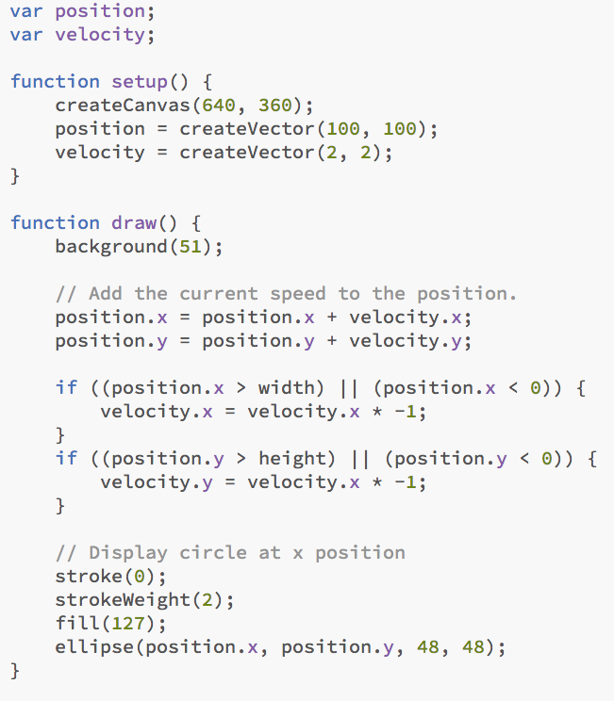
Chapter 2. Vectors
Vector Victor Vector we have a problem....
In the above example, we have a very simple world—a blank canvas with a circular shape (a “ball”) traveling around. This ball has some properties, which are represented in the code as variables.
Location x and y
Speed xspeed and yspeed
In a more advanced sketch, we could imagine having many more variables:
Acceleration xacceleration & yacceleration
Target location xtarget & ytarget
Wind xwind & ywind
Friction xfriction & yfriction
It’s becoming clearer that for every concept in this world (wind, location, acceleration, etc.), we’ll need two variables. And this is only a two-dimensional world. In a 3D world, we’ll need x, y, z, xspeed, yspeed, zspeed, and so on.
Wouldn’t it be nice if we could simplify our code and use fewer variables?
Sketch17.js

Slide 4
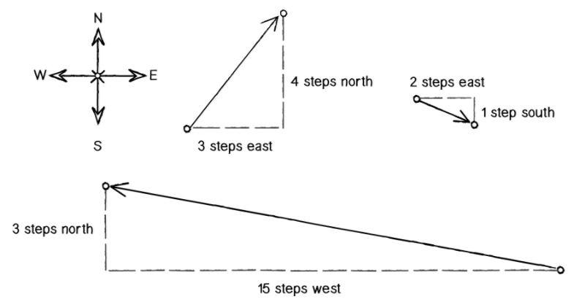
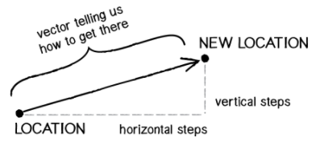
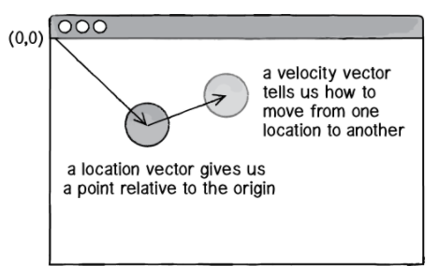
Vectors
One way to think of a vector is the difference between two points. Consider how you might go about providing instructions to walk from one point to another.
(-15, 3)
Walk fifteen steps west; turn and walk three steps north.
(3, 4)
Walk three steps east; turn and walk five steps north.
(2, -1)
Walk two steps east; turn and walk one step south.
You’ve probably done this before when programming motion. For every frame of animation (i.e. a single cycle through Processing’s draw() loop), you instruct each object on the screen to move a certain number of pixels horizontally and a certain number of pixels vertically.
For Every Frame
new location = velocity applied to current location

Slide 5
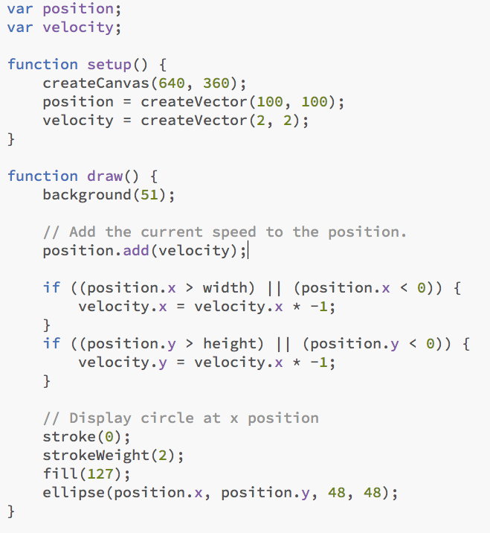
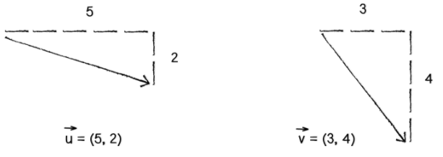
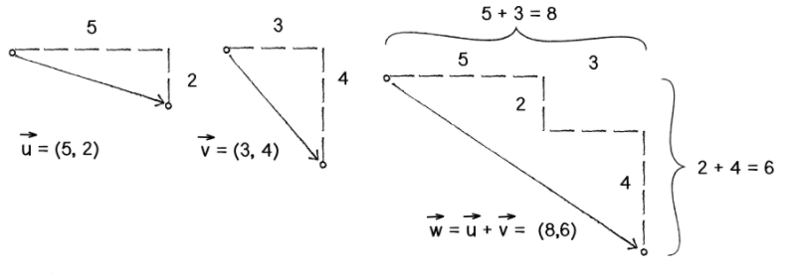
Vector Addition
This is the only line that has changed
Vectors are typically written either in boldface type or with an arrow on top. To distinguish a vector from a scalar (scalar refers to a single value, such as an integer or a floating point number), we’ll use the arrow notation:
Let’s say I have the following two vectors:
Each vector has two components, an x and a y. To add two vectors together, we simply add both x’s and both y’s
Sketch18.js

Slide 6
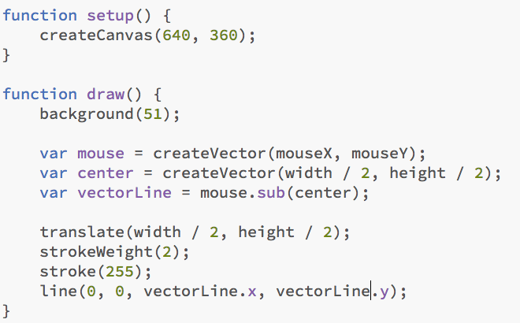
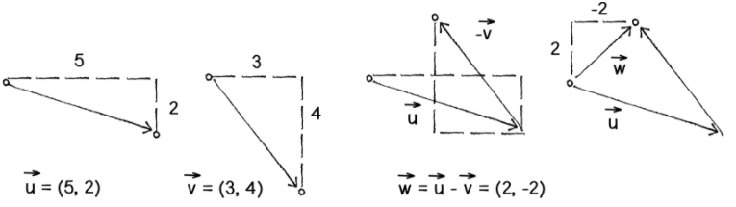
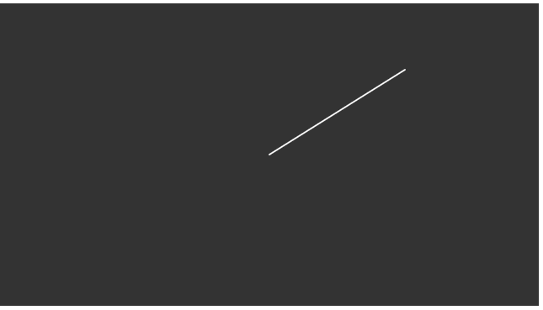
Vector Subtraction
Let’s say I have the following two vectors:
vectorLine
Sketch19.js
Mouse (480,90)
Center (320,180)
vectorLine = Mouse.sub(center) = ((480-320),(90-180) = (160,-90)

Slide 7
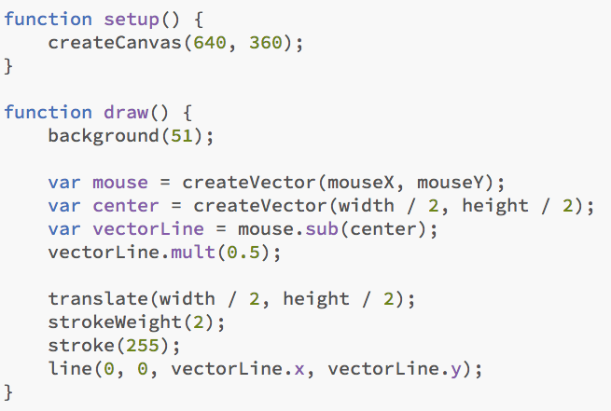
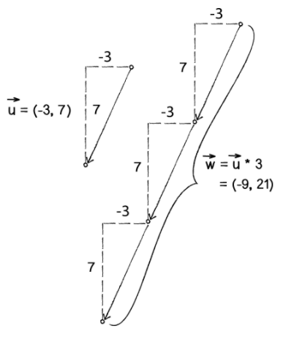
Vector Multiplication/Division
Moving on to multiplication, we have to think a little bit differently. When we talk about multiplying a vector, what we typically mean is scaling a vector.
Sketch20.js
vectorLine
Mouse (480,90)
Center (320,180)

Slide 8
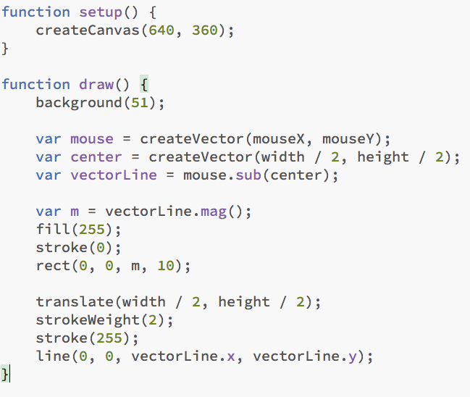
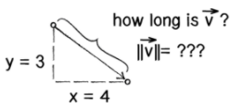

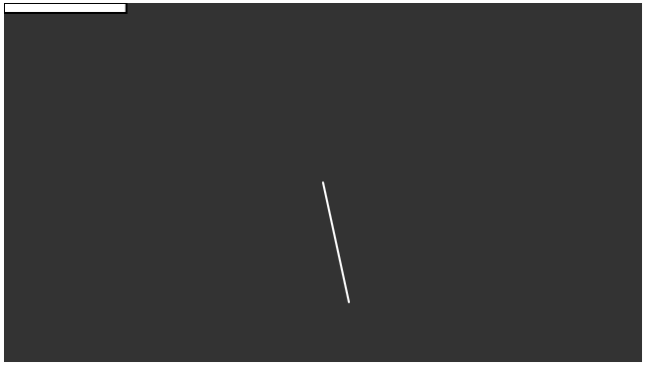
Vector Magnitude
Multiplication and division, as we just saw, are means by which the length of the vector can be changed without affecting direction.
Understanding how to calculate the length (also known as magnitude) of a vector is incredibly useful and important.
Sketch21.js
Center (320,180)
Mouse (360,300)

Slide 9
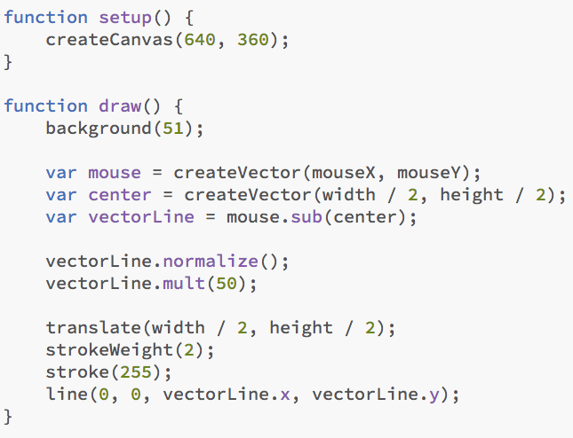
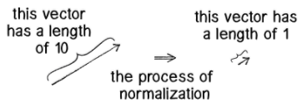
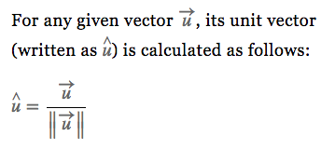
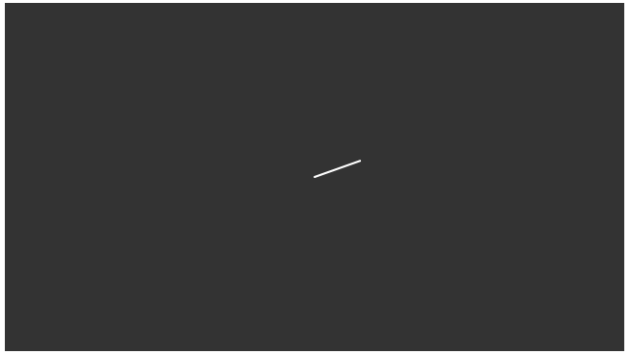
Normalising Vectors
Normalizing refers to the process of making something “standard” or, well, “normal.” In the case of vectors, let’s assume for the moment that a standard vector has a length of 1. To normalize a vector, therefore, is to take a vector of any length and, keeping it pointing in the same direction, change its length to 1, turning it into what is called a unit vector.
Since it describes a vector’s direction without regard to its length, it’s useful to have the unit vector readily accessible.
Sketch22.js
Mouse (480,180)

Slide 10
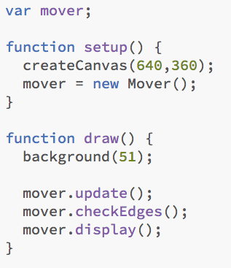
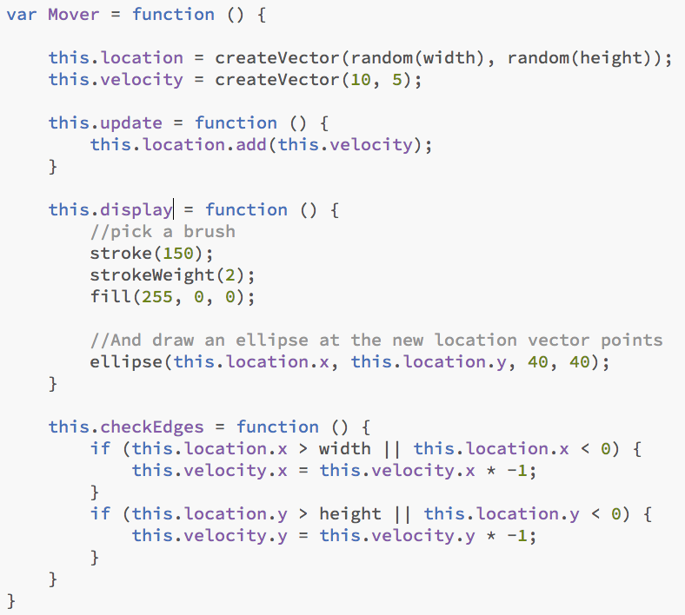
Vector Motion - Velocity
This is Motion 101.
Add velocity to location
Draw object at location
What we want to do now is move towards encapsulating all of the logic for motion inside of a class. This way, we can create a foundation for programming moving objects in Processing.
In this case, we’re going to create a generic Mover class that will describe a thing moving around the screen. And so we must consider the following two questions:
What data does a mover have?
What functionality does a mover have?
Our Motion 101 algorithm tells us the answers to these questions. A Mover object has two pieces of data: location and velocity, which are both PVector objects.
Its functionality is just about as simple. The Mover needs to move and it needs to be seen. We’ll implement these needs as functions named update() and display(). We’ll put all of our motion logic code in update() and draw the object in display().
Sketch23.js
Mouse (480,180)
Mover01.js
mover = {
location:(320,240);
velocity: (10,5);
function update() {location.add(velocity};
function display() { draw an ellipse at the location};
function checkEdges() { checks location relative to canvas};
}

Slide 11
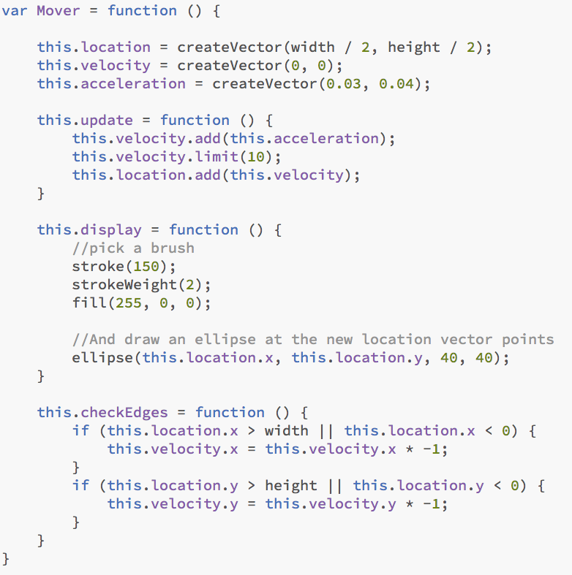
Vector Motion - Acceleration
The strict definition of acceleration we’re using here is: the rate of change of velocity.
Acceleration affects velocity, which in turn affects location
Let’s write every example in the rest of this book without ever touching the value of velocity and location (except to initialize them). In other words, our goal now for programming motion is: Come up with an algorithm for how we calculate acceleration and let the trickle-down effect work its magic.
Acceleration Algorithms!
A constant acceleration
A totally random acceleration
Acceleration towards the mouse
Sketch23.js
Mouse (480,180)
Mover02.js

Slide 12
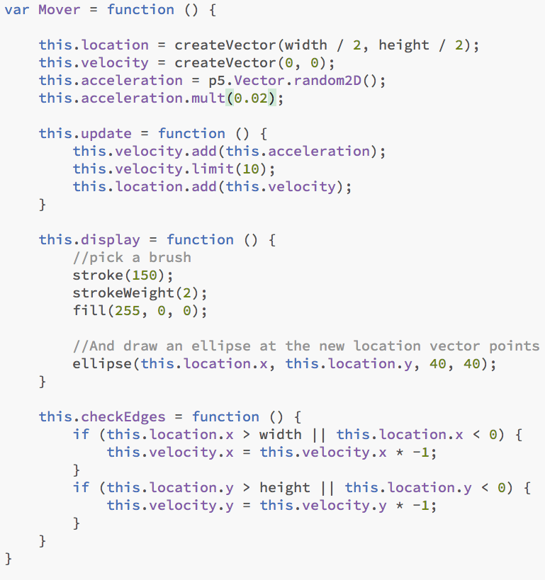
Vector Motion - Acceleration
The strict definition of acceleration we’re using here is: the rate of change of velocity.
Acceleration affects velocity, which in turn affects location
Let’s write every example in the rest of this book without ever touching the value of velocity and location (except to initialize them). In other words, our goal now for programming motion is: Come up with an algorithm for how we calculate acceleration and let the trickle-down effect work its magic.
Acceleration Algorithms!
A constant acceleration
A totally random acceleration
Acceleration towards the mouse
Sketch23.js
Mouse (480,180)
Mover03.js

Slide 13
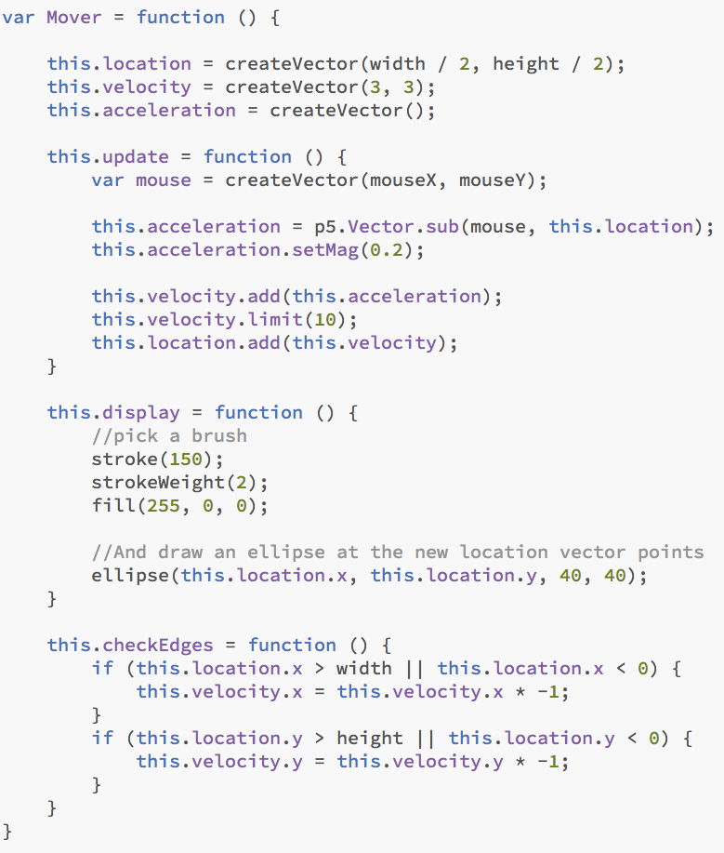
Vector Motion – Acceleration towards the mouse
Before we get to Algorithm #3 (accelerate towards the mouse), we need to cover one more rather important aspect of working with vectors and the PVector class: the difference between using static methods and non-static methods.
Non Static – Called from the object instance
velocity.add(location)
This changes the velocity vector. If we want a new vector returned to us we use a static method as follows
- newVelocity = p5.Vector.add(velocity,location)
Acceleration Algorithms!
A constant acceleration
A totally random acceleration
Acceleration towards the mouse
Sketch23.js
Mouse (480,180)
Mover04.js

Slide 14
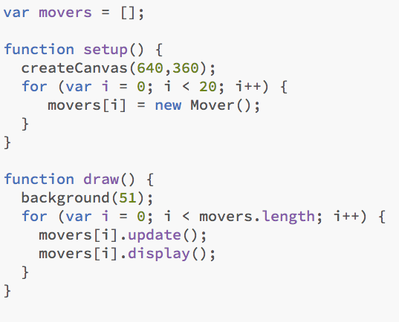
Vector Motion – An Array of Movers
Before we get to Algorithm #3 (accelerate towards the mouse), we need to cover one more rather important aspect of working with vectors and the PVector class: the difference between using static methods and non-static methods.
Non Static – Called from the object instance
velocity.add(location)
This changes the velocity vector. If we want a new vector returned to us we use a static method as follows
- newVelocity = p5.Vector.add(velocity,location)
Acceleration Algorithms!
A constant acceleration
A totally random acceleration
Acceleration towards the mouse
Sketch24.js
Mouse (480,180)
Mover04.js

